Slide 1
Lead Scoring Case Study
By- Srinivasaragavan V
Vishal Yadav

Slide 2
Problem Objective
Problem Statement
An education company named X Education sells online courses to industry professionals. The company markets its courses on several websites and search engines like Google. Once these people land on the website, they might browse the courses or fill up a form for the course or watch some videos. The typical lead conversion rate at X education is around 30%.
Goal:
Build a logistic regression model to assign a lead score between 0 and 100 to each of the leads which can be used by the company to target potential leads.
The CEO, in particular, has given a ballpark of the target lead conversion rate to be around 80%.

Slide 3
Problem Solving Methodology
Identify the data quality and clean the data on necessity basis.
Split data into train and test. Apply Standard Scaling on data.
Based on Successful Logistic Regression model, identify influencing variables.
Data Cleaning and Preparation
Identifying Influencing features
from Model
Apply Logistic Regression
Handle Select and null values based on converted rate without blindly removing those data points.
Apply Logistic Regression using GLM Model on train data and apply RFE.
Draw conclusions and Recommendations from model.
Find Variance Inflation Factor and P-values from Successful Model
Applied Outlier Treatment

Slide 4
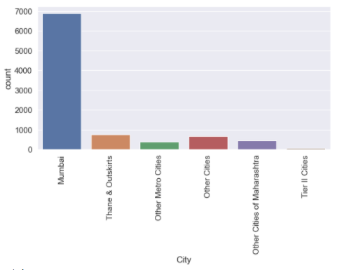
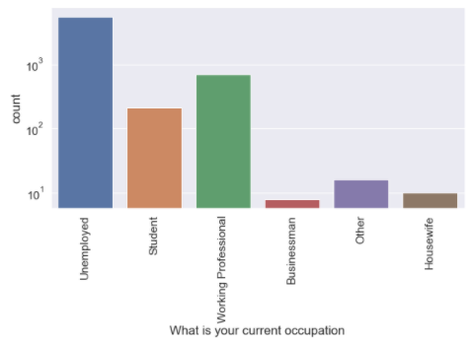
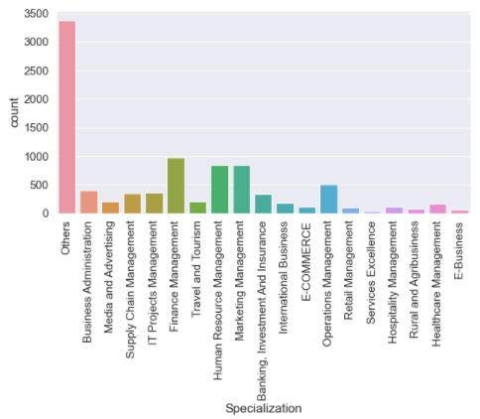
Data Cleaning:
Checked for duplicates values in row.
Dropping unnecessary columns with only null values, single unique feature, rating columns created by sales team after contacting with customers.
Conversion of Select to NAN in data frame.
Dropping attributes high % NA values.
Imputed values with highest count in particular columns
Segregated all NA values into others as separate entity.
Highly skewed columns were dropped.

Slide 5
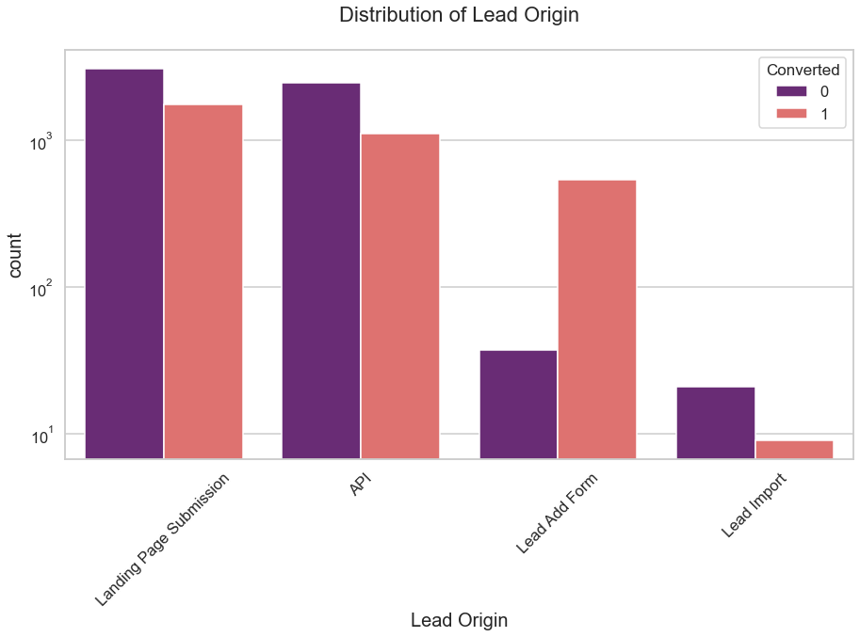
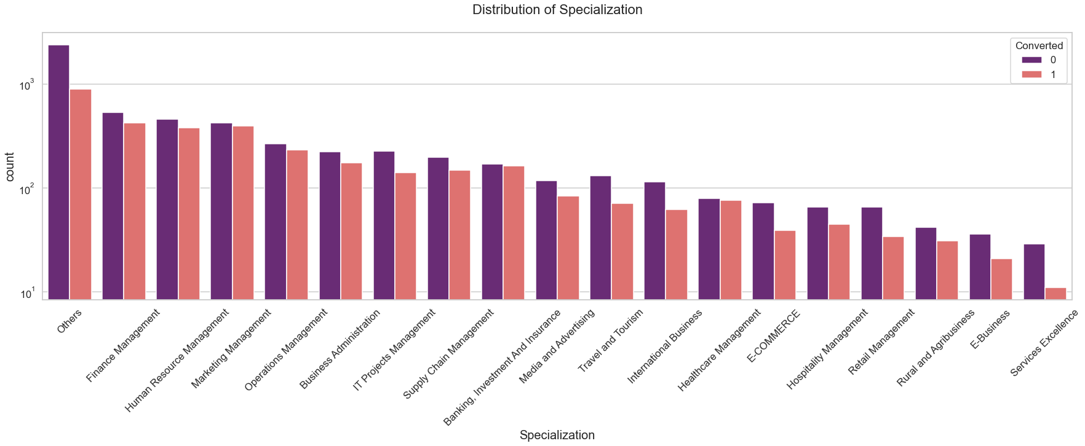
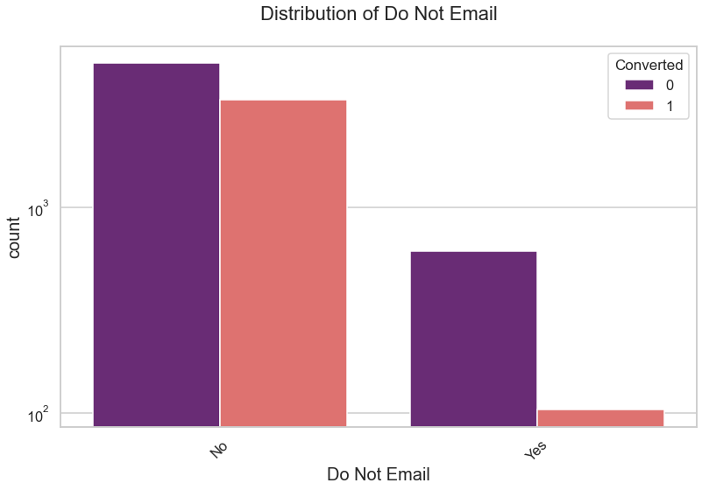
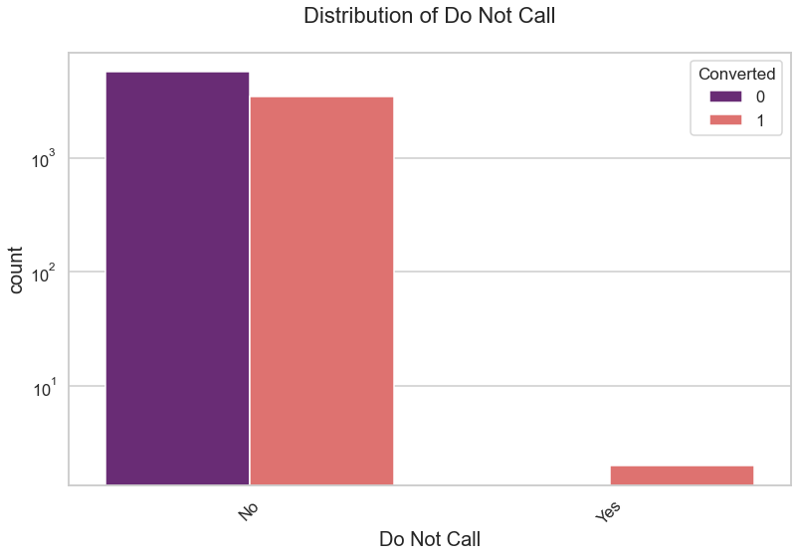
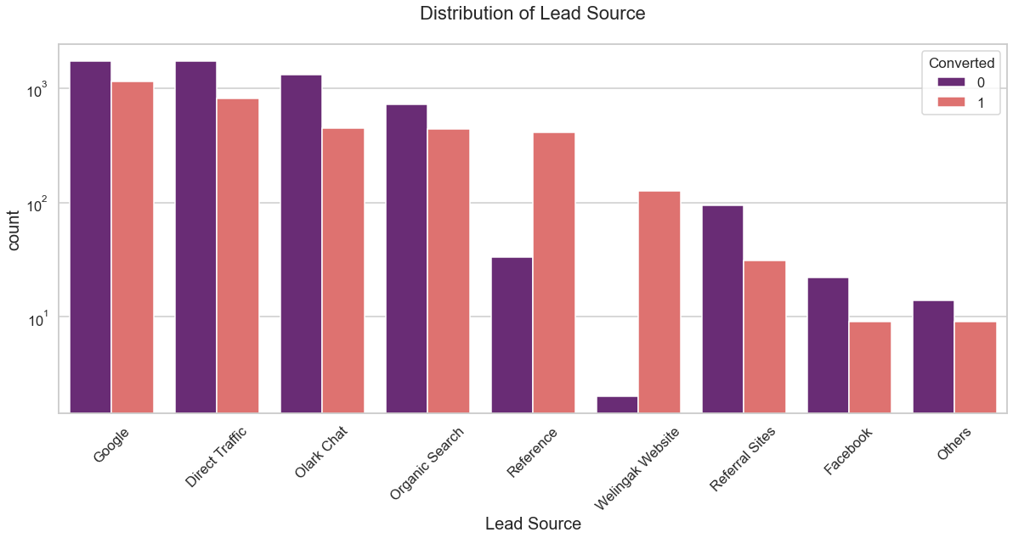
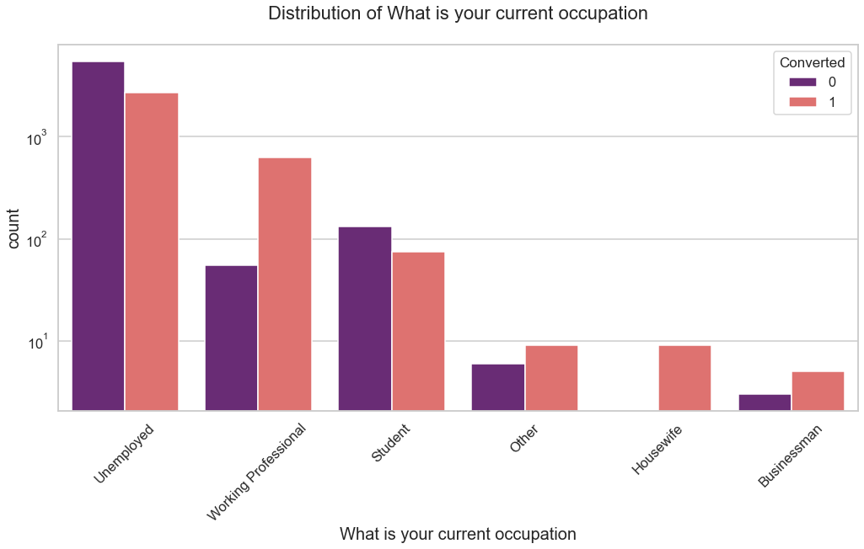
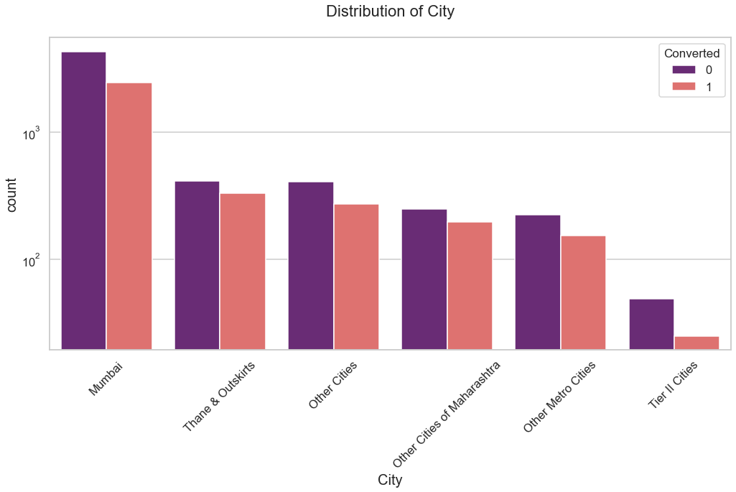
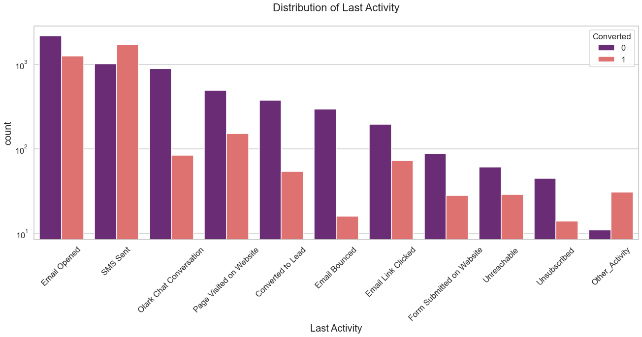
Exploratory Data Analysis- Categorical variable
Following are observations :
Distribution Of Lead Origin
Landing page submission is comparatively high than the rest of the categories
Lead add form has high certainty in lead conversion
Distribution of Lead Source
Google is the best lead source among all other categories in the lead source
Direct Traffic, Olark Chat and Organic Search are some of the best entities in lead source
The best category for lead conversion is Reference and Welingak Website among all the lead source categories
Distribution of Occupation
Working Professionals going for the course have high chances of joining it.
Distribution Of City
Most leads are from Mumbai with around 30% conversion rate.

Slide 6
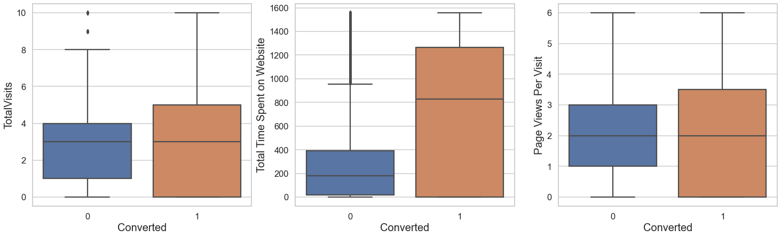
Exploratory Data Analysis- Numerical variable
Following are observations :
Total Visits:
Median for converted and not converted leads are the same.
Nothing conclusive on the basis of Total Visits.
Total Time Spent on Website
Leads spending more time on the website are more likely to be converted.
Website should be made more engaging to make leads spend more time.
Page Views Per Visit
Nothing can be said specifically for lead conversion from Page Views Per Visit

Slide 7
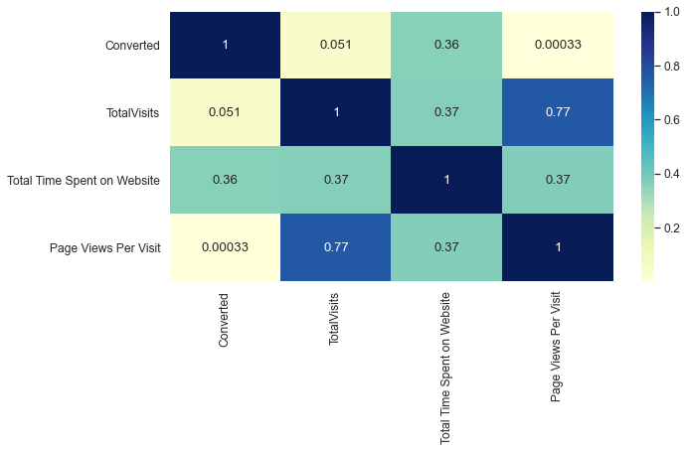
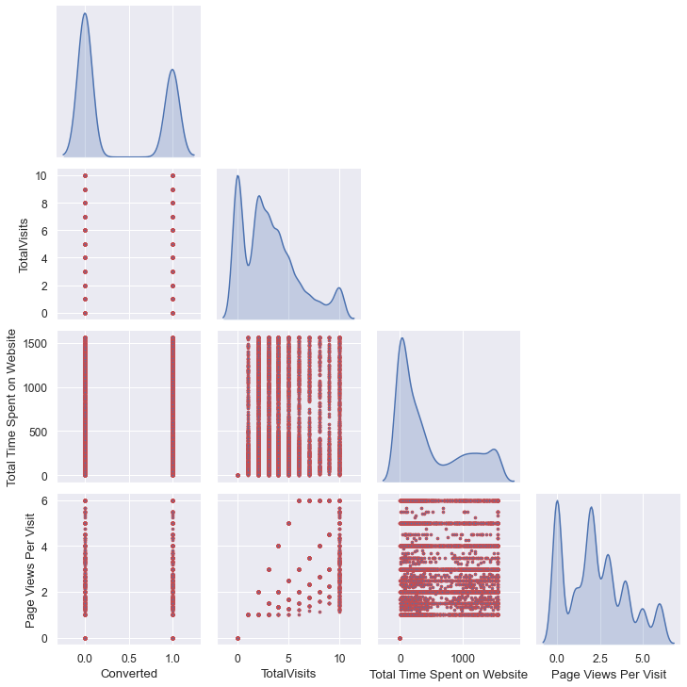
Exploratory Data Analysis- Bi-variate Analysis
Following are observations :
- From pair plot we can observe clearly that our dataset has highly skewed values with lot of random peaks.
With heatmap we draw inference like:
- Total Visits and Page views per Visit has high correlation than other features.
- Total visits and converted has very low correlation i.e. total visit we can derive meaningful lead scoring
- Total visits and Total Time spent on Website have a reasonable correlation result
- There is positive correlation between Total Time Spent on Website and Conversion
- There is almost no correlation in Page Views Per Visit and Total Visits with Conversion

Slide 8
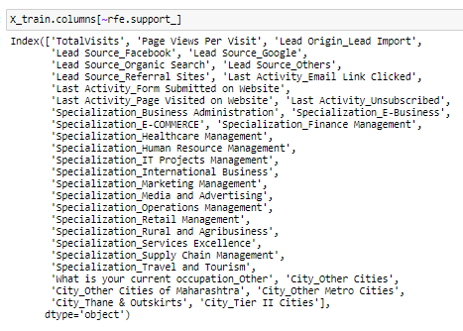
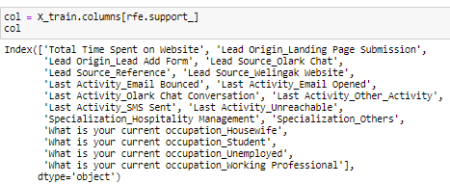
Model Building:
- For model building we need to scale and split data into train and test.
- Using Logistic regression we are building model.
- Variable selection done through RFE (recursive feature elimination) and further manually we removed features with high P value and VIF value.
Analyzing various parameter for train dataset Specificity, Sensitivity, Accuracy, Precision, Recall for train data.
- Plot the ROC Curve: It demonstrates several things:- It shows the tradeoff between sensitivity and specificity (any increase in sensitivity will be accompanied by a decrease in specificity.
Recursive Feature elimination :

Slide 9
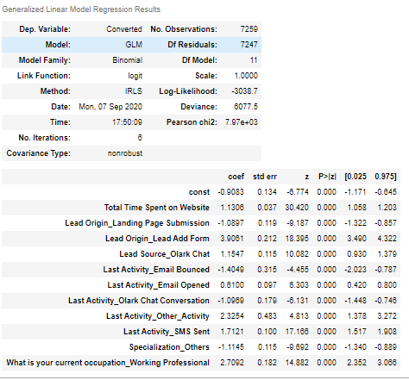
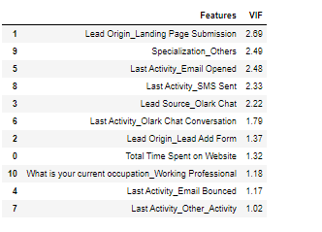
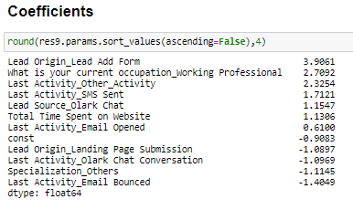
Logistic Regression Model
Using RFE and manual feature elimination for features having P-Value more than 0.05 and VIF more than 5. We reached a final model with P-Value less than 0.05 and VIF less than 5.

Slide 10
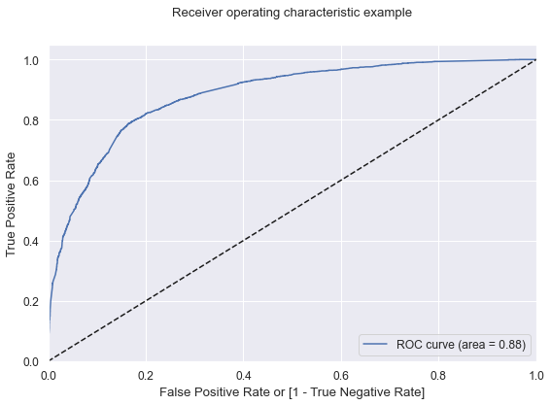
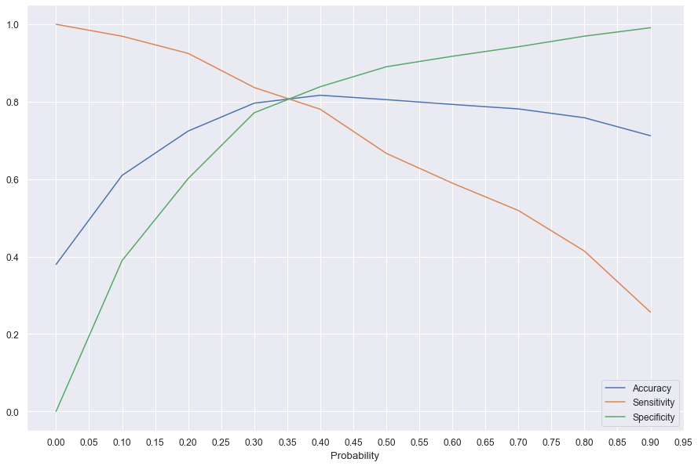
Plotting the ROC Curve
ROC Curve
An ROC curve demonstrates several things:
It shows the trade-off between sensitivity and specificity (any increase in sensitivity will be accompanied by a decrease in specificity).
The closer the curve follows the left-hand border and then the top border of the ROC space, the more accurate the test.
The closer the curve comes to the 45-degree diagonal of the ROC space, the less accurate the test.
Finding Optimal Cut-off Point

Slide 11
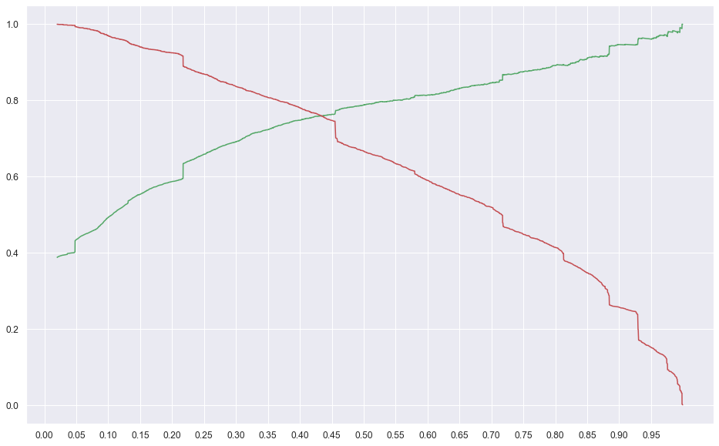
Precision and recall trade-off
As per Precision-Recall Trade-off, the cut-off is around 0.425 (between 0.4 and 0.45) . We can choose the cut-off as 0.47 and use the Precision-Recall-Accuracy metrics to evaluate the model.

Slide 12
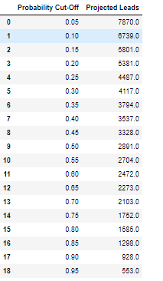
Lead scores for varying cut-off probability
Here we examine the Projected lead scored for different cut-off probability to estimate the lead. So, this will be an useful template to change the cut-off based on business needs.

Slide 13
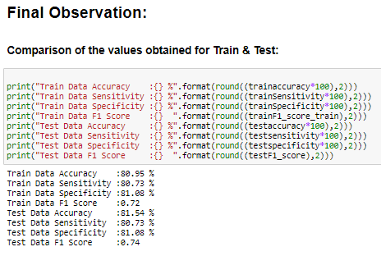
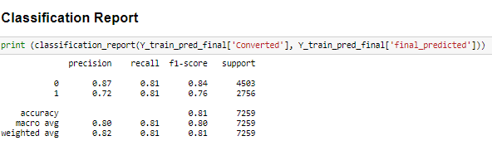
Model Evaluation Statistics

Slide 14
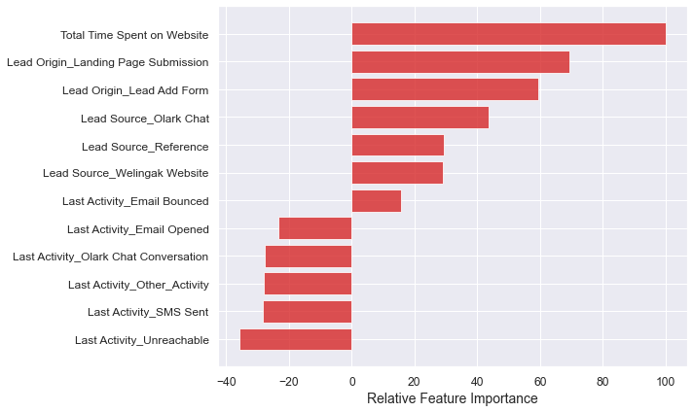
Relative Feature Importance and Recommendations
Recommendations :
X Education Company needs to focus on following key aspects to improve the overall conversion rate:
Increase user engagement on Welingak website since this helps in higher conversion
Focus on Working Professional which has high conversion certainty.
Get Total Time Spent on Website increased by advertising and user experience which makes the customer engaging in the website. since this helps in higher conversion
Improve the Olark Chat service since this is affecting the conversion negatively
Improving Lead add form also improves the lead conversion with high certainty

